Slide 1


TMDB TV Show Database
BIU DS20 Data Science Course | Author: Yonatan Umansky
Predicting the Popularity of TV Shows
Machine Learning Project

Slide 2

What is TMDB?
Over 150K TV Shows data, updated weekly
Features include show genres, language, synopsis, and more
Target Value – Popularity (calculation undisclosed..)

Slide 3

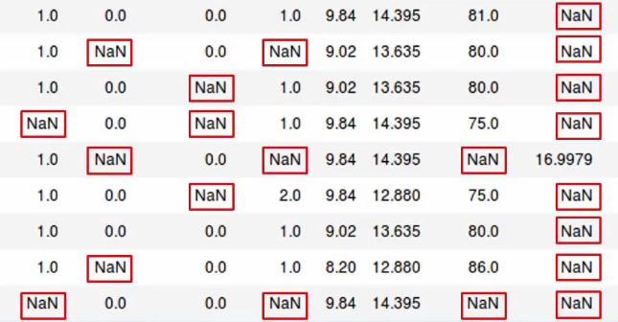
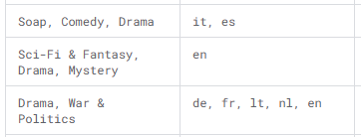

Dataset Challenges
High % of Missing Values
Multi-Value Features
Complete by calling API’s
Restore from free text features
Separate to individual, high level groups
Apply ‘Multi-Hot’ encoding

Slide 4
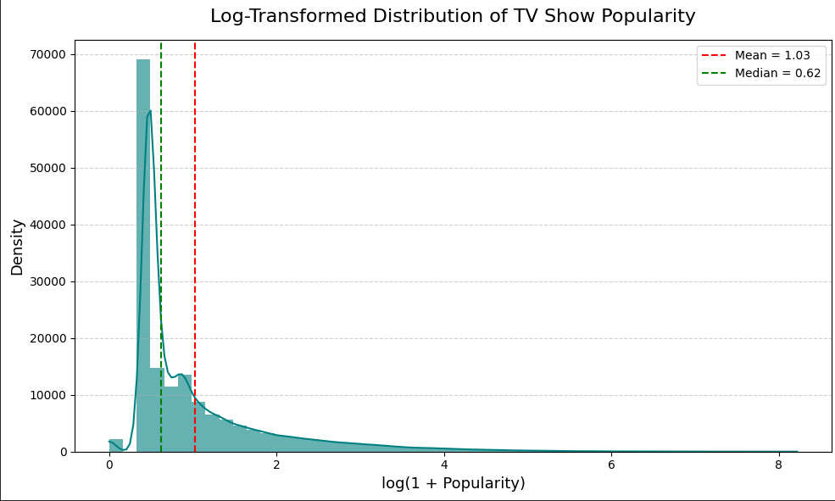

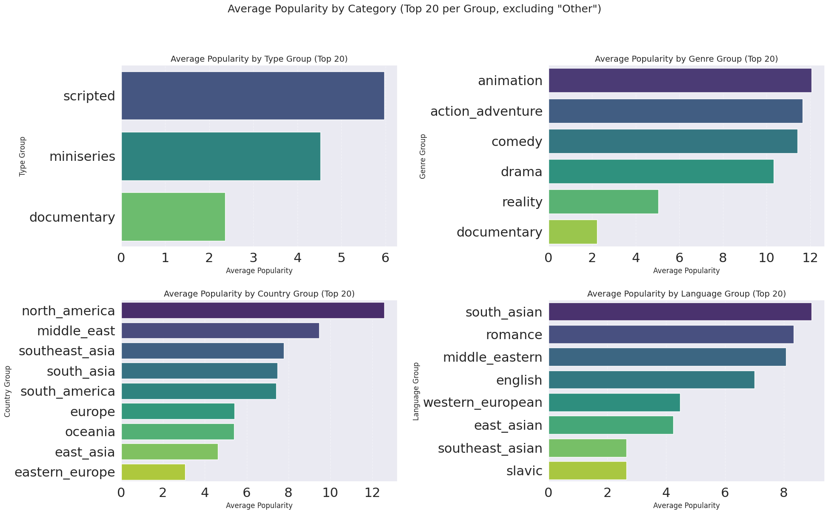

Exploratory Data Analysis (EDA) Insights
EDA focused on identifying relationships between features and the highly skewed target variable, Popularity.
Statistical tests (ANOVA) confirmed statistically significant differences in average popularity across key categorical groups:
TV show genre (comedy, drama, etc.)
TV show type (Scripted, Documentary, etc.)
Regional origin
Original language
No significant correlation was found among the original numerical features (e.g., episode run time, number of seasons).
Target value HIGHLY skewed

Slide 5



Data Preparation Workflow
Data Cleaning
Transformation & Encoding
Outlier Treatment & Feature Selection
Complete missing values as much as possible
Remove features with mostly NaNs
Convert data types
Consolidate categories to more comprehendible lists
Add new calculated features
Encode categories with ‘one-hot’ and ‘multi-hot’ methods
Identify using box-plots and IQR
Impute using MICE
Determine feature importance (Ridge,Lasso)

Slide 6
Model Selection and Evaluation
A Regression approach was chosen for the continuous target variable. Data was split into Train (70%), Dev (15%), and Test (15%) segments
Model
RMSE
MAE
R²
Baseline Regression
39.71
7.89
0.149
Random Forest Regressor
37.10
5.5
0.258
Gradient Boosting
38.28
6.03
0.210
XGBoost
38.47
5.69
0.202
The Random Forest Regressor was selected as the final model due to its best performance across all key metrics: lowest RMSE and highest R² (0.258)

Slide 7



Model Fine-Tuning Results
Randomized Search and Grid Search methods were used to fine-tune the Random Forest Regressor for optimal parameters.
0.258
0.309
34.88
Initial R²
Final R²
Final RMSE
While fine-tuning provided marginal improvements, the overall predictive ability (R² remains low) suggests inherent data limitations are the primary constraint.

Slide 8

Summary: Limitations and Future Outlook
Performance Constraints
Missing Crucial Features
Skewed Target
The TMDB database lacks strong external predictors of success:
The highly skewed nature of the popularity metric challenges standard regression models
Production cost/budget
Key cast members names
Persistent Missing Data
Initial pilot rating or market testing data
Despite extensive imputation efforts, missing values in key categorical features limited model accuracy

Slide 9
Summary: Opportunities
Improved Prediction Ability
Business Implementation
A more comprehensive dataset with fewer missing values could produce a valuable popularity prediction model
A good TV show popularity predictor could be valuable for production companies or streaming networks seeking to increase revenue

Slide 10
Thank You!

